Slide 1


Slide 2
What is
?
A library for managing states with reducers
Basic functionnal programming wizardry brought to the masses
A briant piece of work by Dan Abramov (and many others)

Slide 3
What’s a reducer ?
A simple function that take state
and an action,
And returns a new state

Slide 4
Redux reducers handle state transitions, but they must be
handled synchronously

Slide 5
But what about async?
User interactions
AJAX
Web socket
Animations

Slide 6
…and, harder to manage…
Composing multiple async sources
AJAX Cancellation
Composed AJAX
Debounced form submission
Drag & drop
Advanced Web socket use

Slide 7
A high-level look at asynchrony in Redux
Async
1. Dispatch
action
2. Call API
3. Get Response
Components
Redux
store
API
4. Store Data
4. Store Error
5. Render

Slide 8
Redux manage asynchrony with middlewares
Most redux middlewares use callBacks or promises

Slide 9
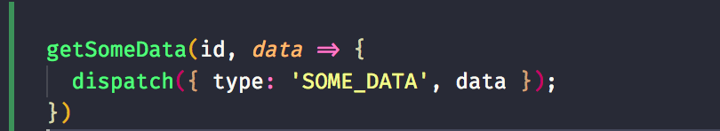
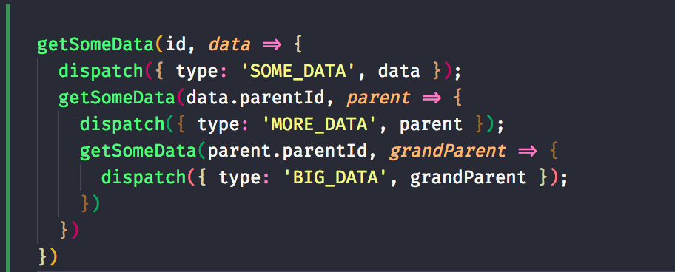
Callbacks

Slide 10
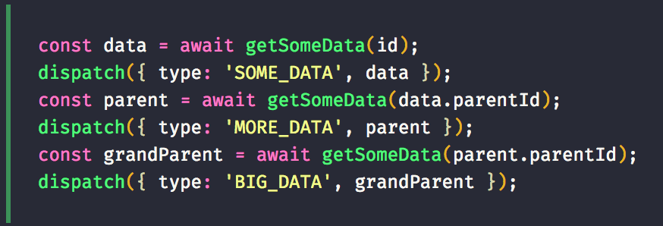
With promises (cleaner)

Slide 11
Promises
Guarenteed future
Immutable
Single value
Catching

Slide 12
Promises
Guarenteed future
Immutable
Single value
Catching

Slide 13
Promises
Guarenteed future
Immutable
Single value
Catching
Auto-complete
Changes before data finishes loading

Slide 14
Observables
A set of events
Any number of values
Over any amount of time
Cancellable
Lazy

Slide 15
RxJS
Observables and functions to create and compose Observables
“Lodash for async”

Slide 16
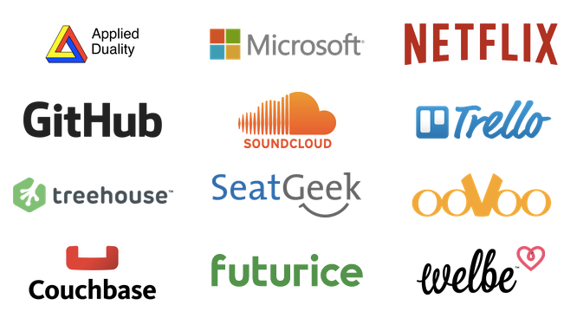
RxJS

Slide 17
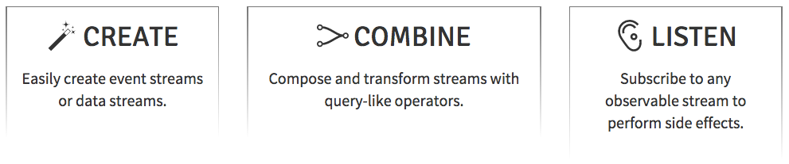
RxJS

Slide 18
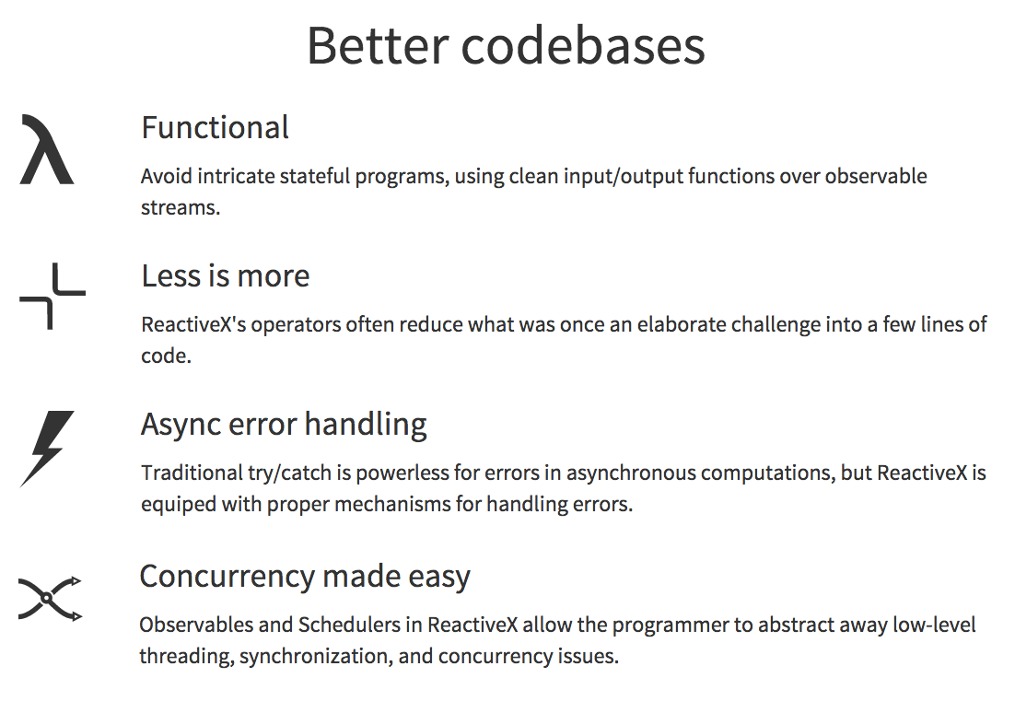
RxJS

Slide 19
Observables
Observable
Flip
X
Subscriber

Slide 20
Create Observables
of('hello')
from([1, 2, 3, 4])
interval(1000)
ajax('http://example.com')
webSocket('ws://echo.websocket.com')
fromEvent(button, ‘click')
many more...

Slide 21
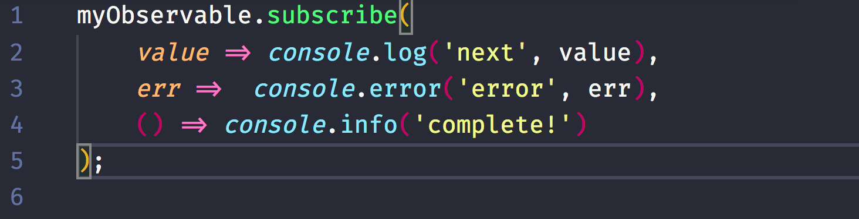
Subscribe an Observable

Slide 22
+
=

Slide 23
EPICS
INPUT: Action over time in an Observable
OUTPUT: Downstream actions in an Observable
A function that takes a stream of all actions dispatched
and returns a stream of new actions to dispatch
Jay Phelp, Netflix

Slide 24
DEMO
Use EPICs in Redux

Slide 25
Pros/Cons
+
-
Make it easy to compose and control complex async tasks with RxJS and Redux
Can use Redux tooling
You don’t end up managing your own Rx subscriptions
If used with react-redux, makes all of your components stateless
Need to know redux in advance
Should learn RxJS in advance
RxJs has a bit of a learning curve

Slide 26

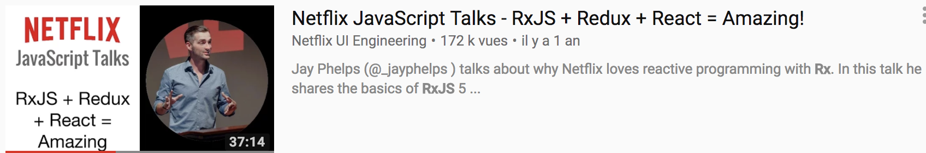


Slide 27
Questions ?

